Slide 1
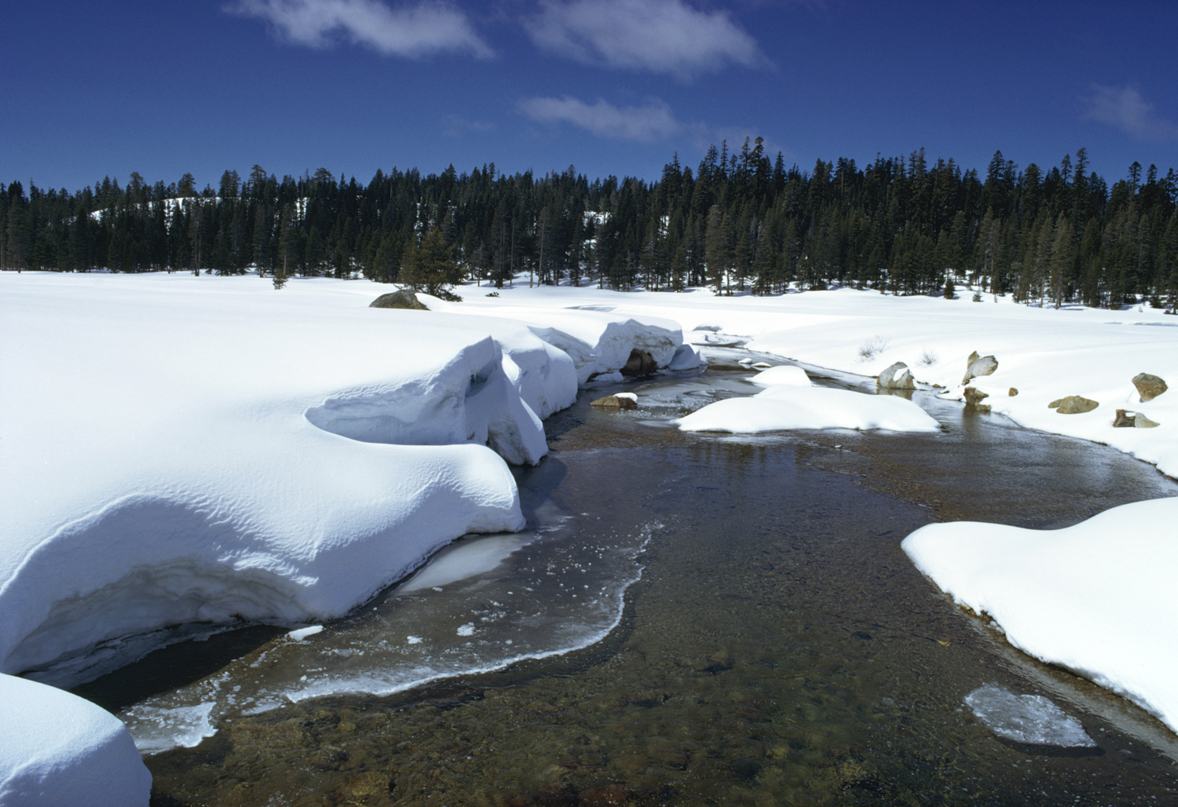
CLIMATE CHANGE RESOURCES
AT THE DEPARTMENT OF WATER RESOURCES
Lauma M. Jurkevics - DWR, Southern Region, Climate Change Specialist
March 27, 2013
Southern California Water Dialogue

Slide 2
DWR Climate Program
Team of managers, scientists, engineers,
administrators, and interns from
headquarters and the regional offices
Develop guidance on
addressing CC & GHGs
Provide outreach &
technical assistance
www.water.ca.gov/climatechange
Outreach
Data
Guides

Slide 3
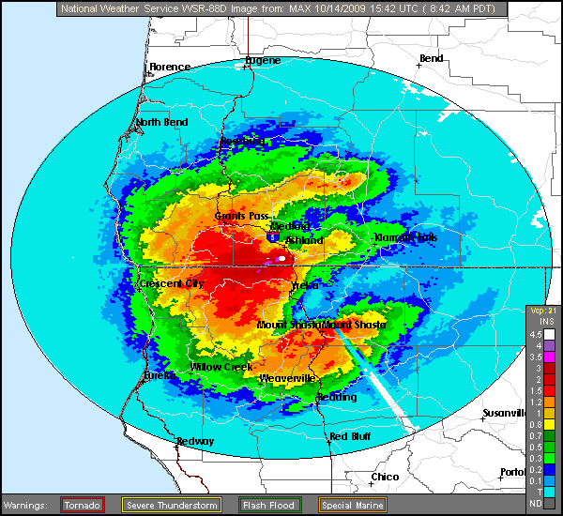
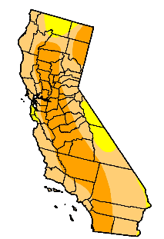
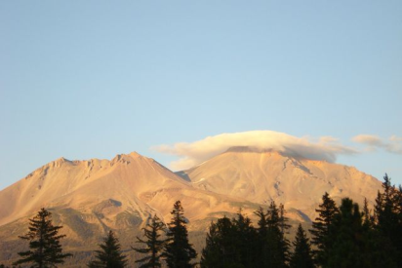
In the Next 40 years….
0.9 – 3.6º F temp rise
25 - 40 % less snowpack
More intense wet and dry periods
Higher flood peaks
Less summer runoff
Sea Level rise: 4-16” (7-55” by end of century)
Increased salinity in the Delta
Notes:
0.9-3.6ºF = 0.5-2ºC
Temp increase by 2100 - 3.5-11ºF or 1.9-6ºC

Slide 4
Statewide Strategies for Adaptation
Practice & promote integrated flood management
Enhance & sustain ecosystems
Expand water storage & conjunctive management
of surface & groundwater resources
Fix Delta water supply, quality, and ecosystem
conditions
Notes:
Statewide Adaptation Strategies for California’s water from White Paper/CCAS
California’s current water resource infrastructure is already strained to meet competing objectives, for water supply, flood control, ecosystem health, water quality, hydropower, and recreation. The current system of reservoirs, canals, floodplains, and levees must be modified and managed differently for greater flexibility during exacerbated droughts and floods. Flood systems must also be enhanced to accommodate higher variability of flood flow magnitude and frequency. Resolution of long-standing issues related to water management, ecosystems, water quality, and public safety in the Sacramento-San Joaquin Delta must also be addressed.
These adaptation strategies will be incorporated into CWP Update 2013 in 4 areas

Slide 5
Climate Change in CWP 2013
Regional Reports
Regionally appropriate adaptation strategies
Scientifically sound approach to address CC
Future Climate Scenarios
Climate Change Technical Advisory Group
Resource Management Strategies
Climate Change Adaptation
Greenhouse Gas Mitigation
Statewide Strategies
Highlights & key recommendations

Slide 6
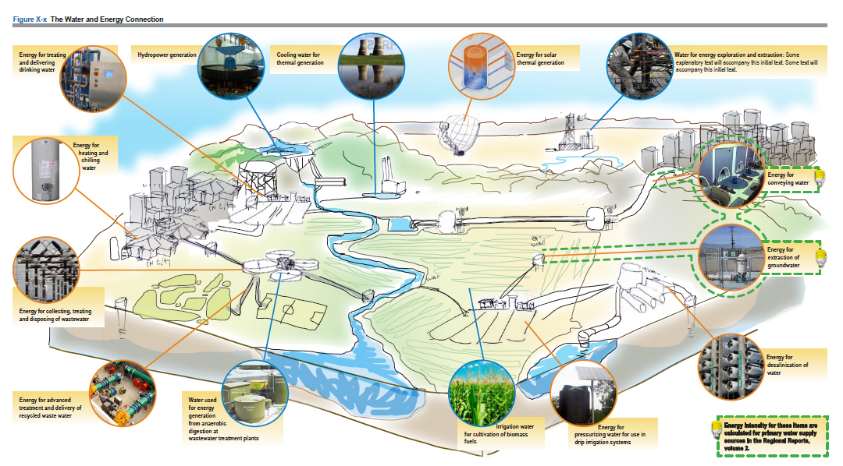
Climate Change in CWP 2013
Water-Energy Nexus
CA Water Today Water-Energy Paper
Notes:
CWP climate change Water-Energy nexus graphic: CA Water Today Water-Energy Paper (graphic of where water is used for energy and vice versa, along with text that’s being drafted with regards to W-E

Slide 7
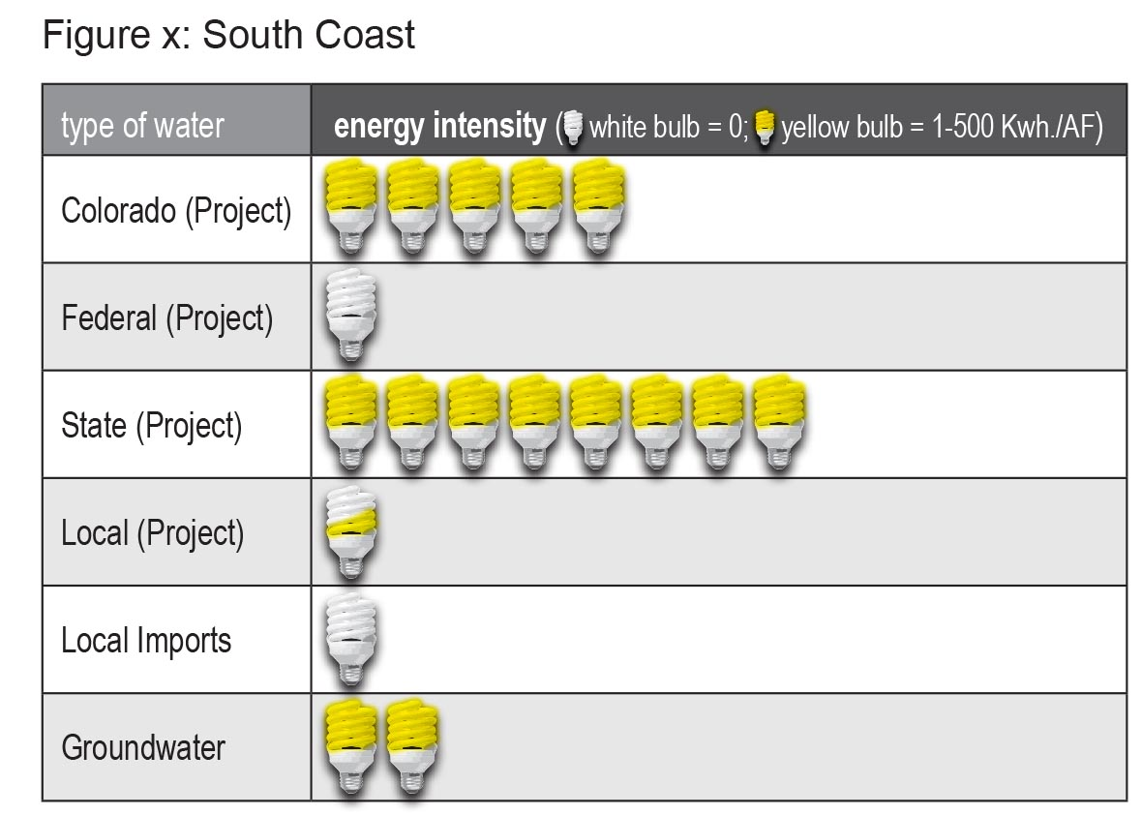
Climate Change in CWP 2013
Energy Intensity - Extraction and Conveyance
Each Regional Report
Notes:
CWP Regional Report EXAMPLE Energy Intensity for Raw water extraction and conveyance: South Coast (these water sources are the ones more easily quantified). For DeSal, recycled, and hydropower discussions, our team will work with subject matter experts to address those water types in text format, rather than in the “lightbulb” figure.

Slide 8
Mitigation of GHGs in the Ag Water Sector
Building the SOM (Soil Organic Matter)- Soil rich in organic matter holds more carbon, water, and nutrients
Practicing No-till or Low-Till Farming- Undisturbed soil is able to retain more carbon, crop residues assist in building SOM, and less equipment passes mean less GHG emissions (and less fuel costs!)
Notes:
Some of the techniques to mitigate climate change in agriculture…

Slide 9
Mitigation of GHGs in the Ag Water Sector
Maintaining Pump Efficiency – Inefficient pumps consume electricity; routine maintenance and efficiency reduce GHG emissions and save money
Adopting drip, overhead or micro-irrigation technologies – Pumping water is a huge energy cost and source of GHG emissions – conserve water, conserve energy
Notes:
Some of the techniques to mitigate climate change in agriculture…

Slide 10
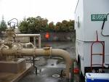
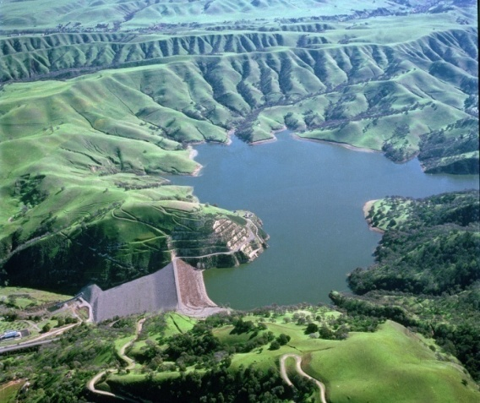
Regional Strategies for Adaptation
Aggressively increase water use
efficiency
Fully implement Integrated
Regional Water Management
(IRWM)
Notes:
Regional Adaptation Strategies for California’s water from White paper/CCAS
Note ~ water-energy nexus as related to WUE
2010 IRWM Guidelines – new standard for climate change

Slide 11
Prop 84 IRWM Implementation Round 1 Primary Benefit
Notes:
A quick show of the types of projects that are funded through IRWM.
An additional analysis was conducted looking at how the funded projects met statewide priorities. Climate change was the number one statewide priority that the projects help achieve.
No matter what the reason was for conceiving the projects, many also help adapt to climate change→ good integrated water management is totally consistent with goals for adapting to climate change and climate change just makes these kinds of activities more important.

Slide 12
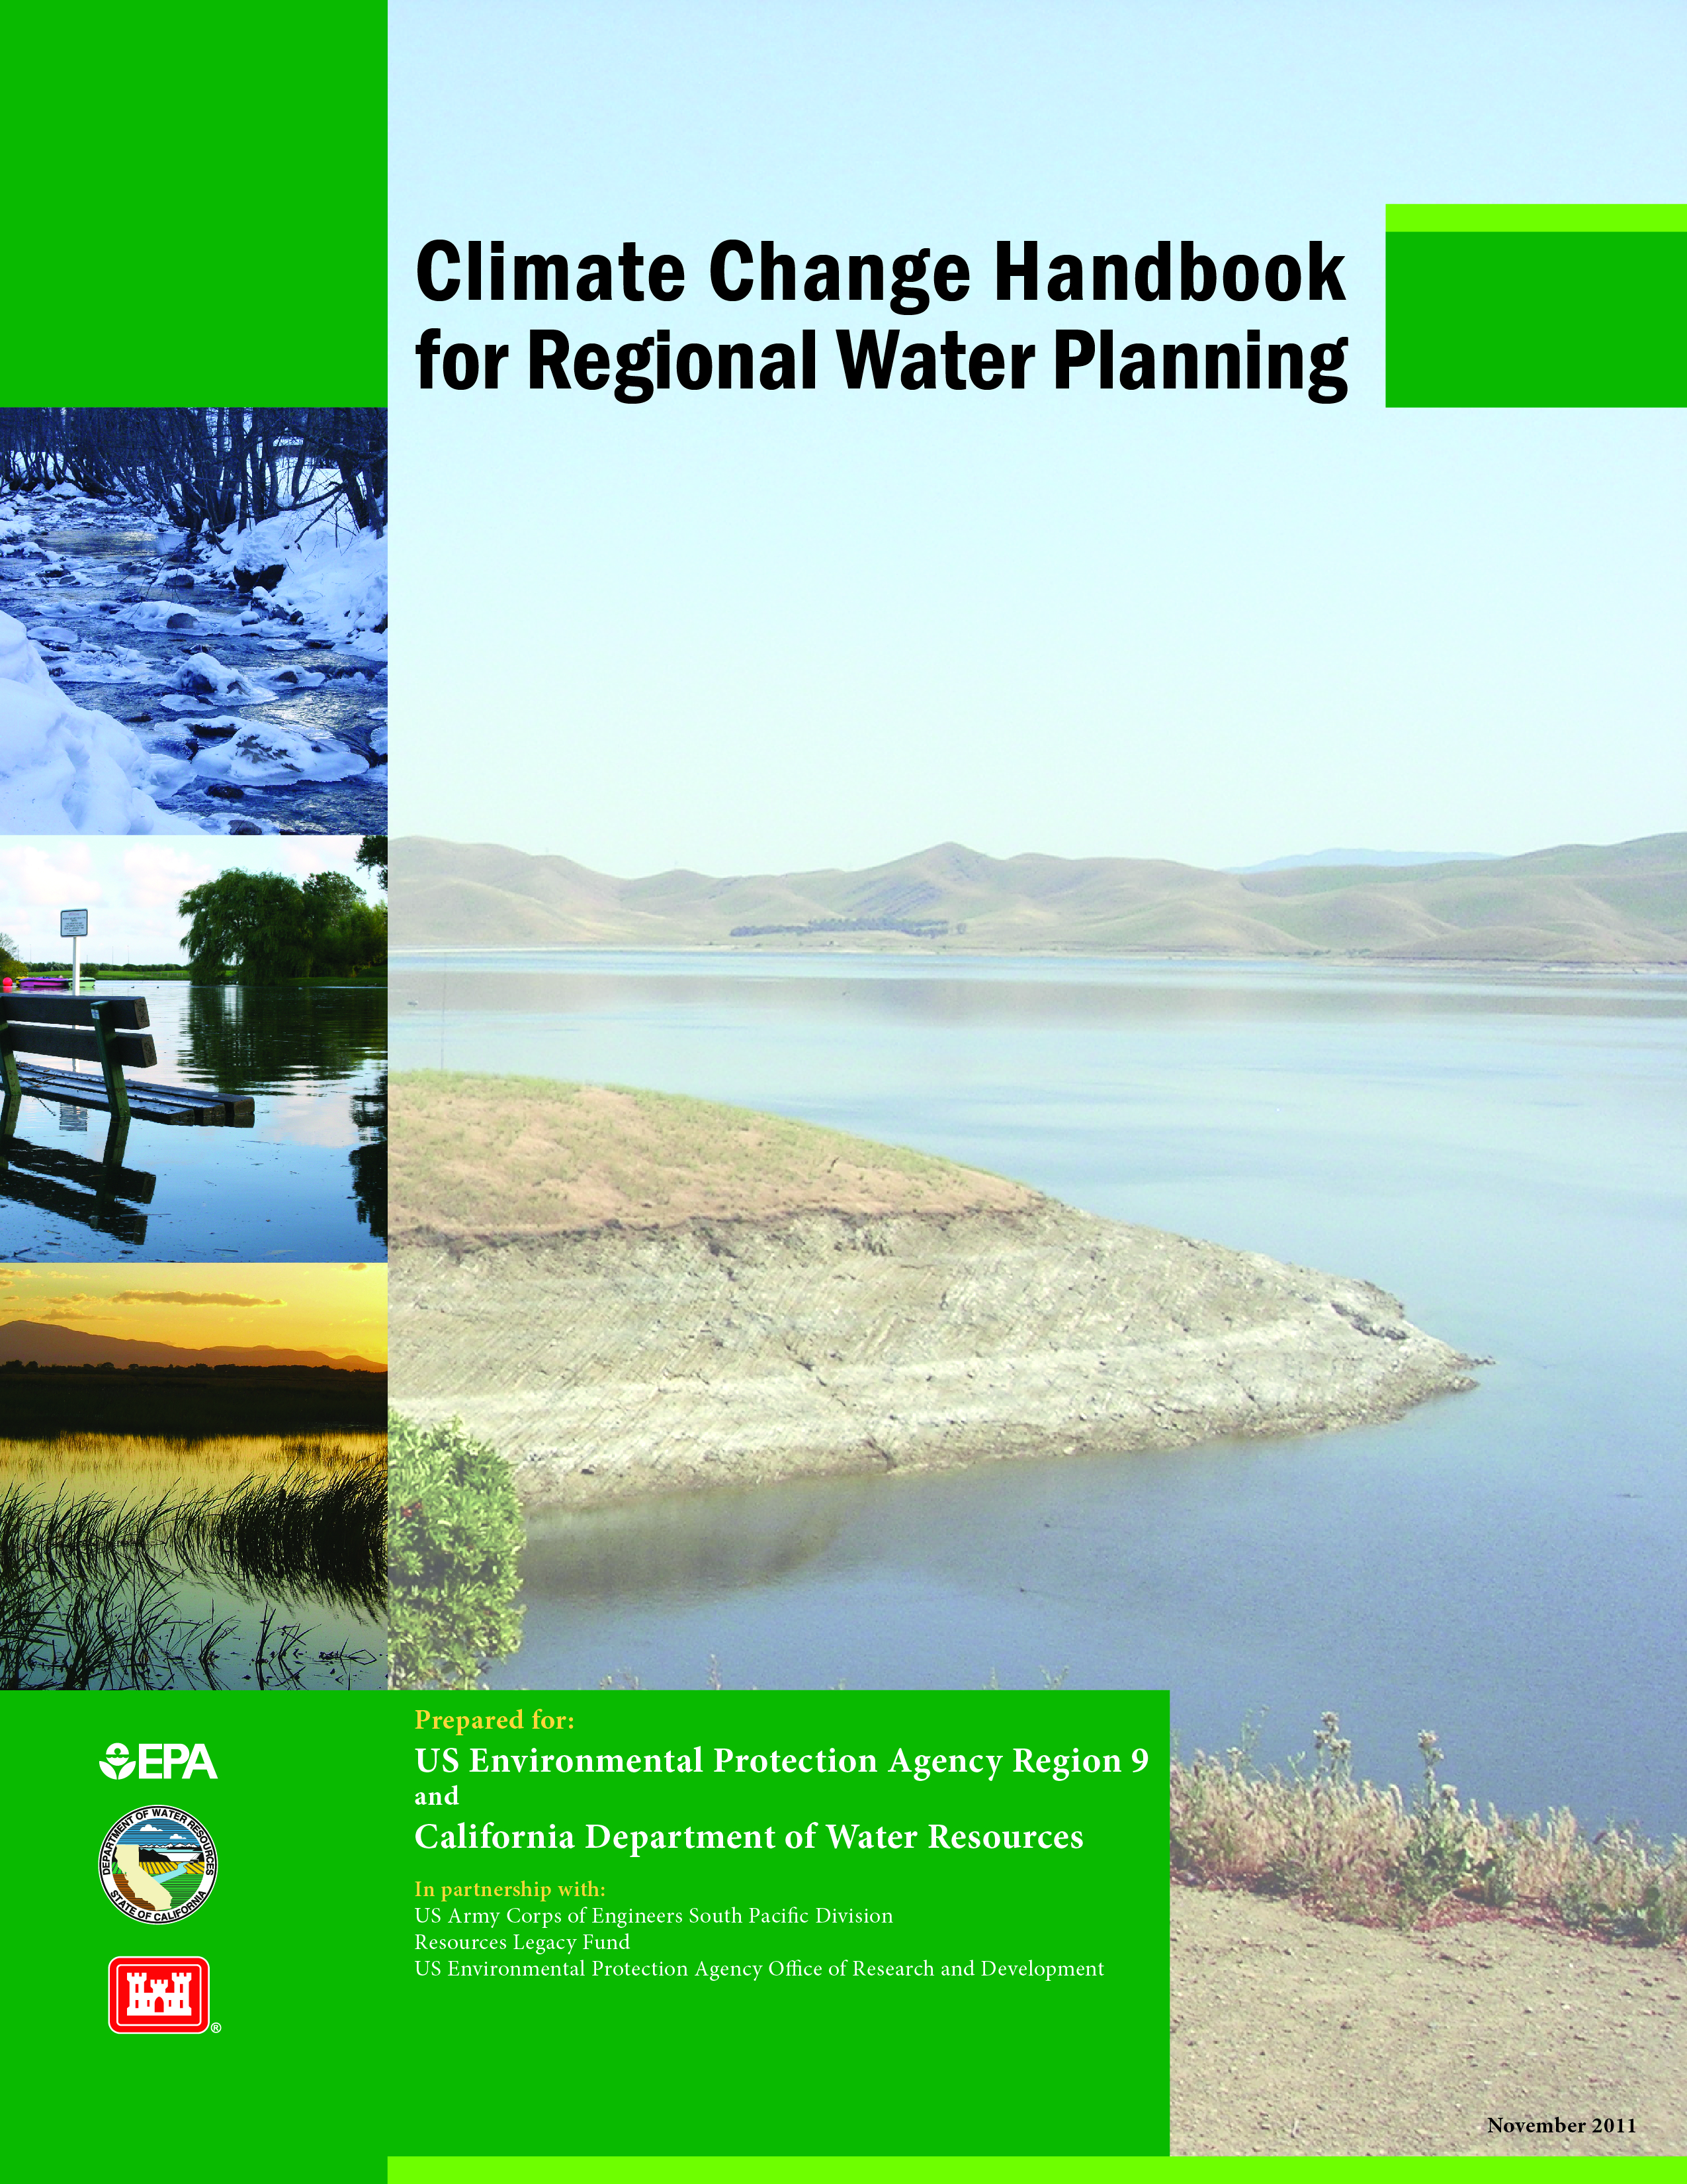
Climate Change Handbook for Water Planning
www.water.ca.gov/climatechange/CCHandbook.cfm
Notes:
Recognized need for guidance on how to address climate change in water planning - resulted in development of Handbook
Jointly developed by EPA, DWR, USACE & Resources Legacy Fund
Prepared by CDM
Available on our website (limited hardcopies available)

Slide 13
Handbook’s Purpose
Outline the general process for
accounting for climate change in
water planning
Synthesize available literature in a
way that is useful for regional water
planning
Support IRWM planning in California

Slide 14
What the Handbook is NOT
A cookbook
A one-size-fits-all methodology or
approach
An extension of or an addition to the
IRWM Guidelines
A requirement
Notes:
Planners should view this handbook as more of a guidebook with a menu of options rather than a manual or step-by-step guide.
Climate change planning, like all aspects of IRWM planning, should be regionally appropriate, considering the specific vulnerabilities, risks, capabilities, and priorities of the region.

Slide 15
Climate Change Analysis
Notes:
The climate change analysis process is something new for IRWMP practitioners. These are the steps that most cc analyses go through (vulnerability assessment, impact analysis, evaluating strategies, and implementing under uncertainty)

Slide 16
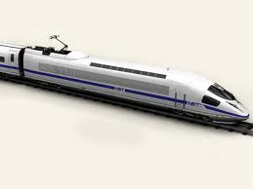
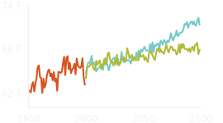
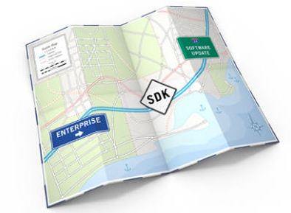
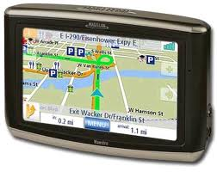
Linking Up With Other Efforts
California Adaptation
Policy Guide
Notes:
Transportation metaphor. The APG is kind of the overall road map… the lay of the land, gives you the general directions and how to get there. The Handbook is more like the detailed directions that you get from your friend—when you get off the freeway turn right at the light, it’s the third house on the left. This is the detailed directions. And Cal-Adapt is like the highspeed rail (the idealized highspeed rail!) Its cheap, efficient, and fast. Anyone can use it without any specialized knowledge. And its going to get you to the general area that you need to get to, it isn’t perfect but it’s a great option to have. There are more sophisticated tools/models (LA is working on some modeling that will be more like the Lexus or Tesla!) but their more costly and more complex.
But one thing to realize is that even with all of these great tools and resources—there still isn’t a chauffer with a GPS. You aren’t going to be able to plug in some information about your region and sit back and have the answer given to you. There is still a lot of regional customization and thinking that will need to be done.

Slide 17
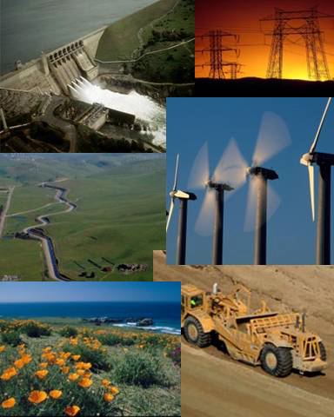
DWR GGERP
California Department of Water Resources
Climate Action Plan Phase I: Greenhouse Gas Emissions Reduction Plan http://www.water.ca.gov/climatechange/CAP.cfm
Notes:
First state agency to make such a plan. The web page lists the targets and amazingness of DWR in this regard!!! It can be used as an example for other water managers who want to address GHG, too.

Slide 18
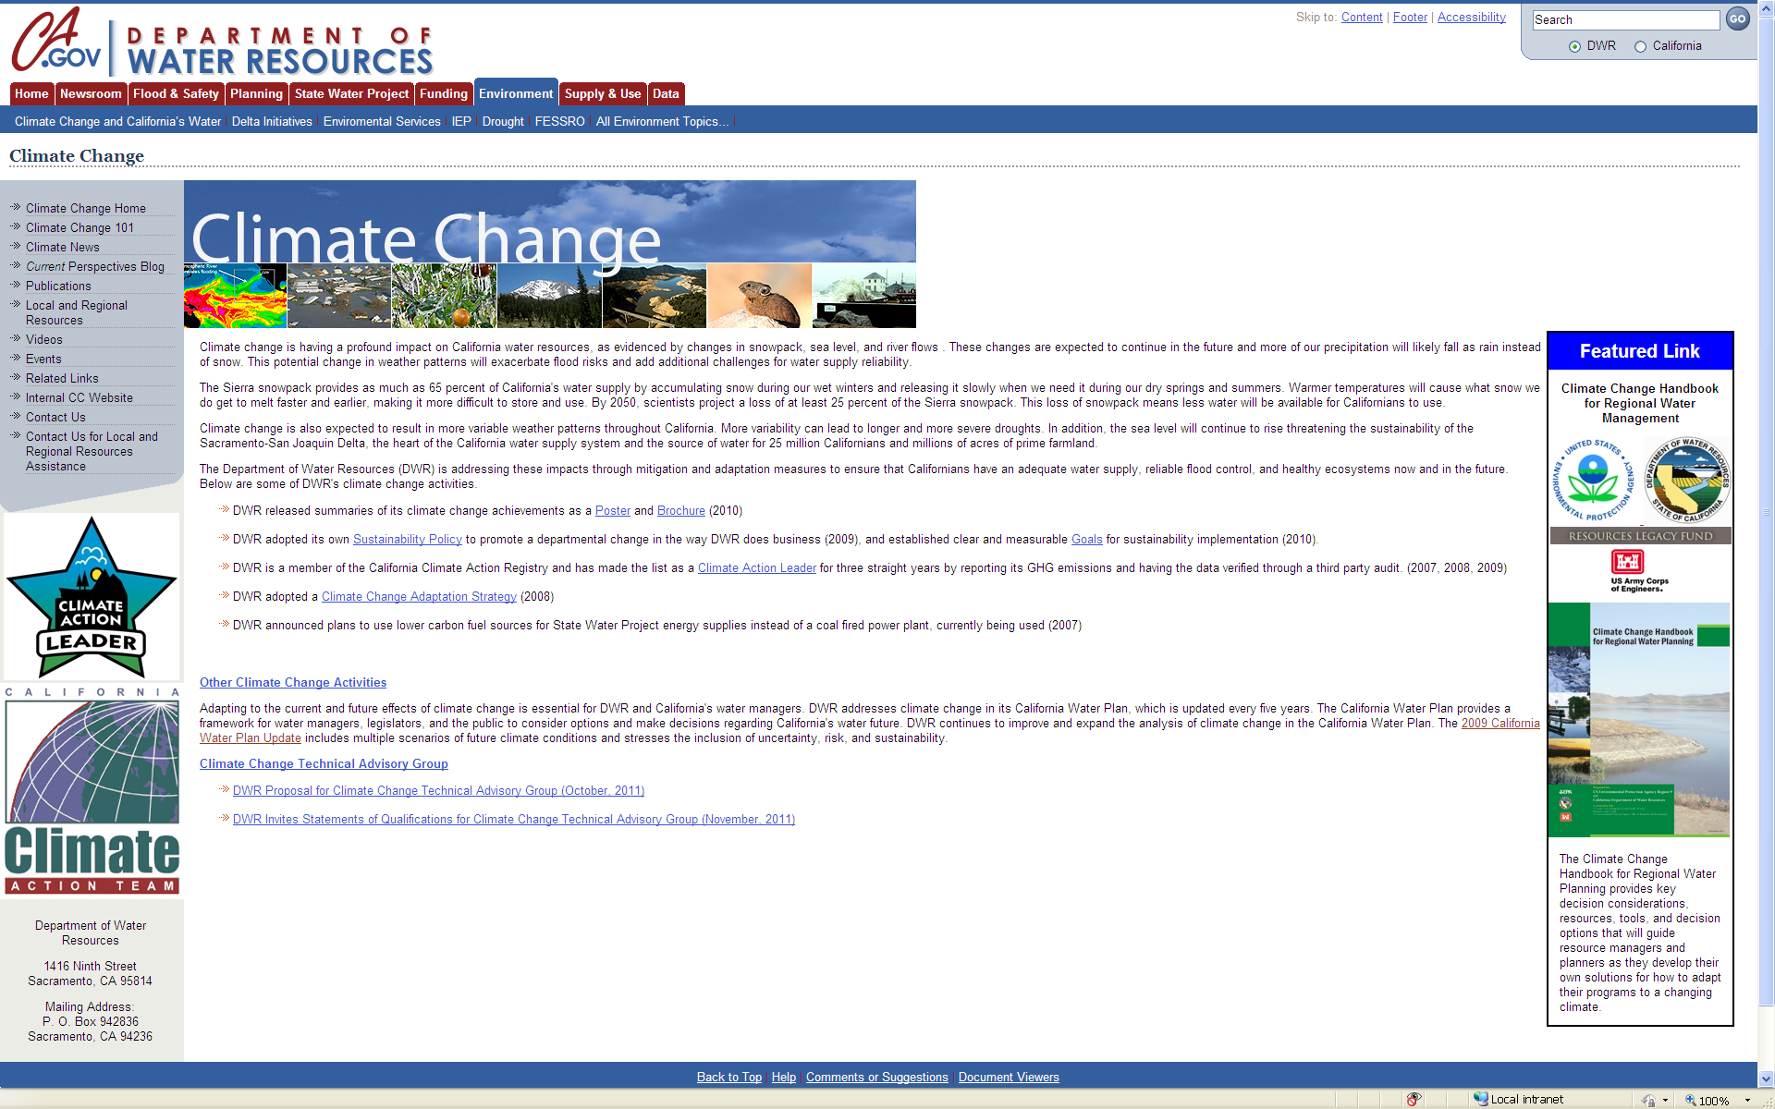
Notes:
More information on climate change resources related to water management and making those links can be found on our website.

